Slide 1

Organizing a soccer team
An automated approach to find heuristic-based solutions for defensive positioning of soccer players.
MPE – ProDEI – Tiago Mendes-Neves – up201406104@fe.up.pt

Slide 2
Motivation
Preparation of a soccer game has a very extensive checklist.
Defensive positioning in certain game situations is one item.
Can AI (Optimization algorithms) help in this regard?

Slide 3
No | Authors | Title | Year | Source title | Cited by | DOI | Algorithms | Approach
1 | Laureano, M.A.P., Tonidandel, F. | Performing and blocking passes in small size league | 2019 | Proceedings - 2019 Latin American Robotics Symposium, 2019 Brazilian Symposium on Robotics and 2019 Workshop on Robotics in Education, LARS/SBR/WRE 2019 |  | 10.1109/LARS-SBR-WRE48964.2019.00012 | Particle Swarm Optimization | RoboCup; Set Pieces positioning; Blocking pass lines only
2 | Larik, A., Haider, S. | A framework based on evolutionary algorithm for strategy optimization in robot soccer | 2019 | Soft Computing | 3 | 10.1007/s00500-018-3376-6 | Genetic Algorithms | RoboCup; General positioning; Goal difference, regions occupied and ball possession
3 | Laureano, M.A.P., Tonidandel, F. | Analysis of the PSO Parameters for a Robots Positioning System in SSL | 2019 | Lecture Notes in Computer Science (including subseries Lecture Notes in Artificial Intelligence and Lecture Notes in Bioinformatics) | 1 | 10.1007/978-3-030-35699-6_10 | Particle Swarm Optimization | RoboCup; General positioning; Minimizing distance, block the view of the opposing robot to a point of interest, block the view of the goal, (respect SSL rules)
4 | Agarwalla, A., Jain, A.K., Manohar, K.V., Saxena, A.T. | Bayesian optimisation with prior reuse for motion planning in robot soccer | 2018 | ACM International Conference Proceeding Series | 2 | 10.1145/3152494.3152502 | Bayesian optimisation | -
5 | Henn, T., Henrio, J., Nakashima, T. | Optimizing player’s formations for corner-kick situations in RoboCup soccer 2D simulation | 2017 | Artificial Life and Robotics | 1 | 10.1007/s10015-017-0364-3 | Firefly algorithm | RoboCup; Corner kick; Simulation
6 | Larik, A.S., Haider, S. | On using evolutionary computation approach for strategy optimization in robot soccer | 2016 | 2016 2nd International Conference on Robotics and Artificial Intelligence, ICRAI 2016 | 2 | 10.1109/ICRAI.2016.7791220 | Genetic Algorithms | See 2.
Notes:
No consensus about what algorithm to use.

Slide 4
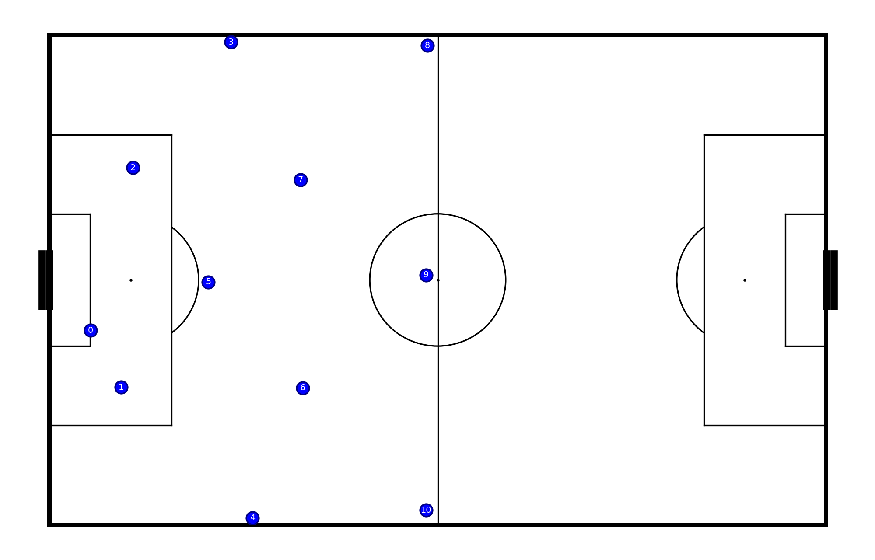

Problem definition
11 opposition players
Dependent on the use case
E.g., Goal kick

Slide 5
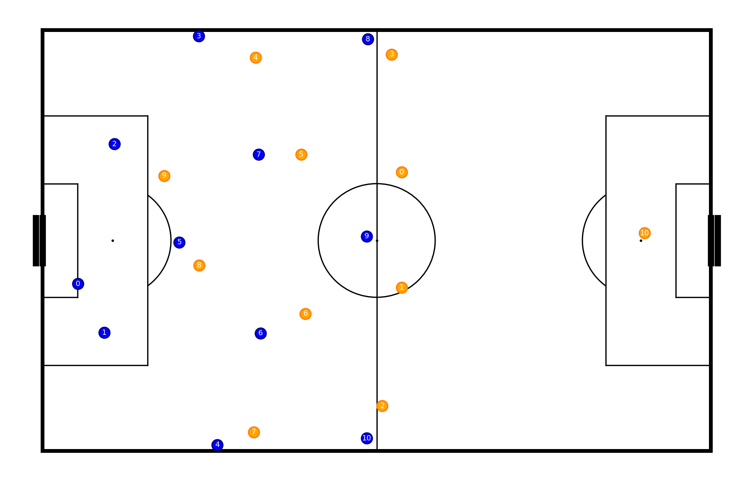
Problem definition
11 opposition players
Dependent on the use case
E.g., Goal kick
We want to position 11 defensive players
11 (x,y) tupples

Slide 6
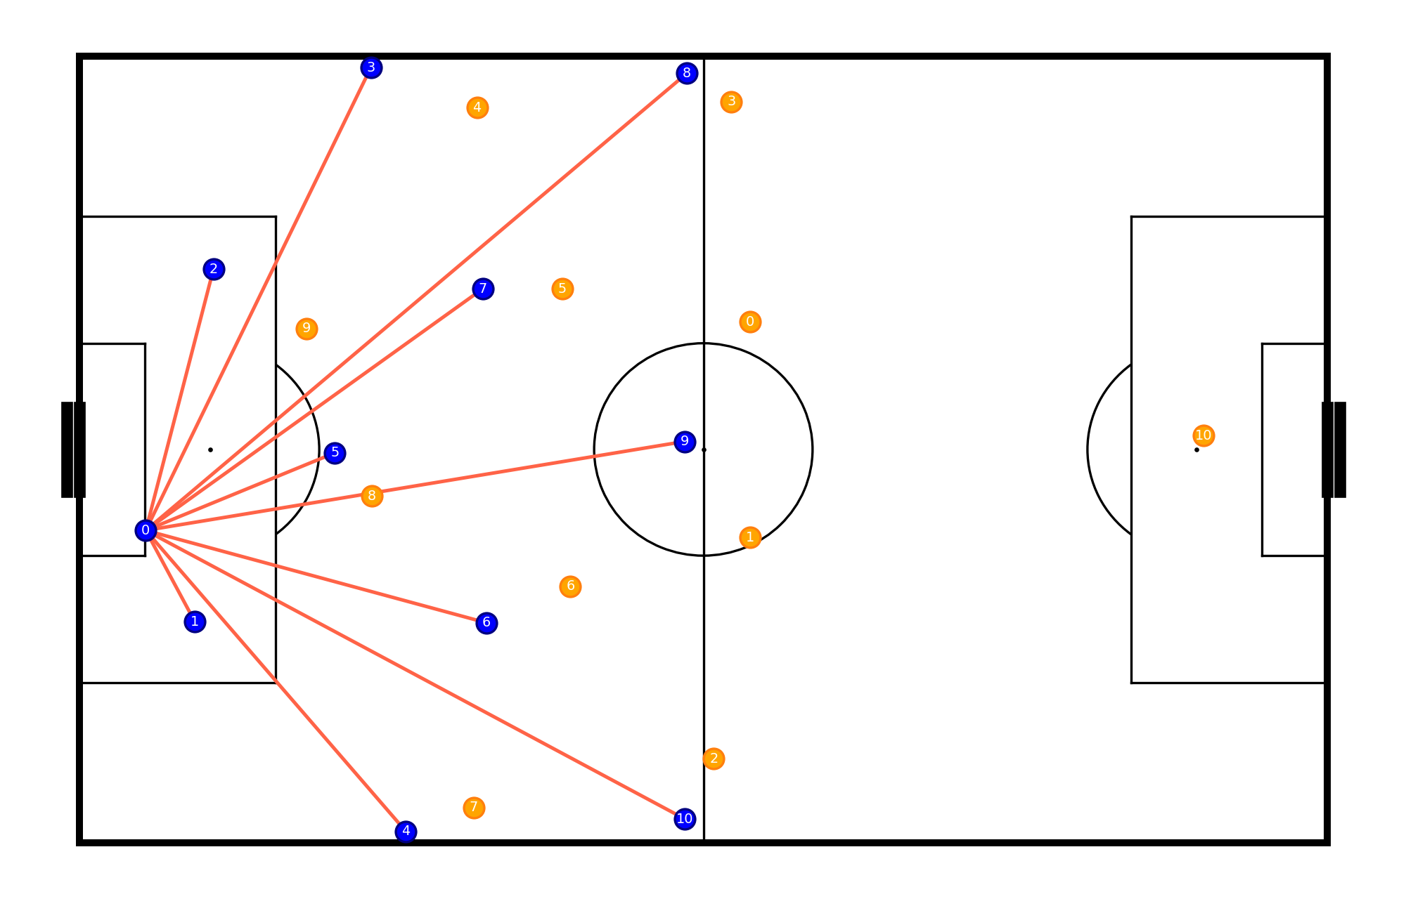
Criteria 1
Maximize coverage of pass lines

Slide 7
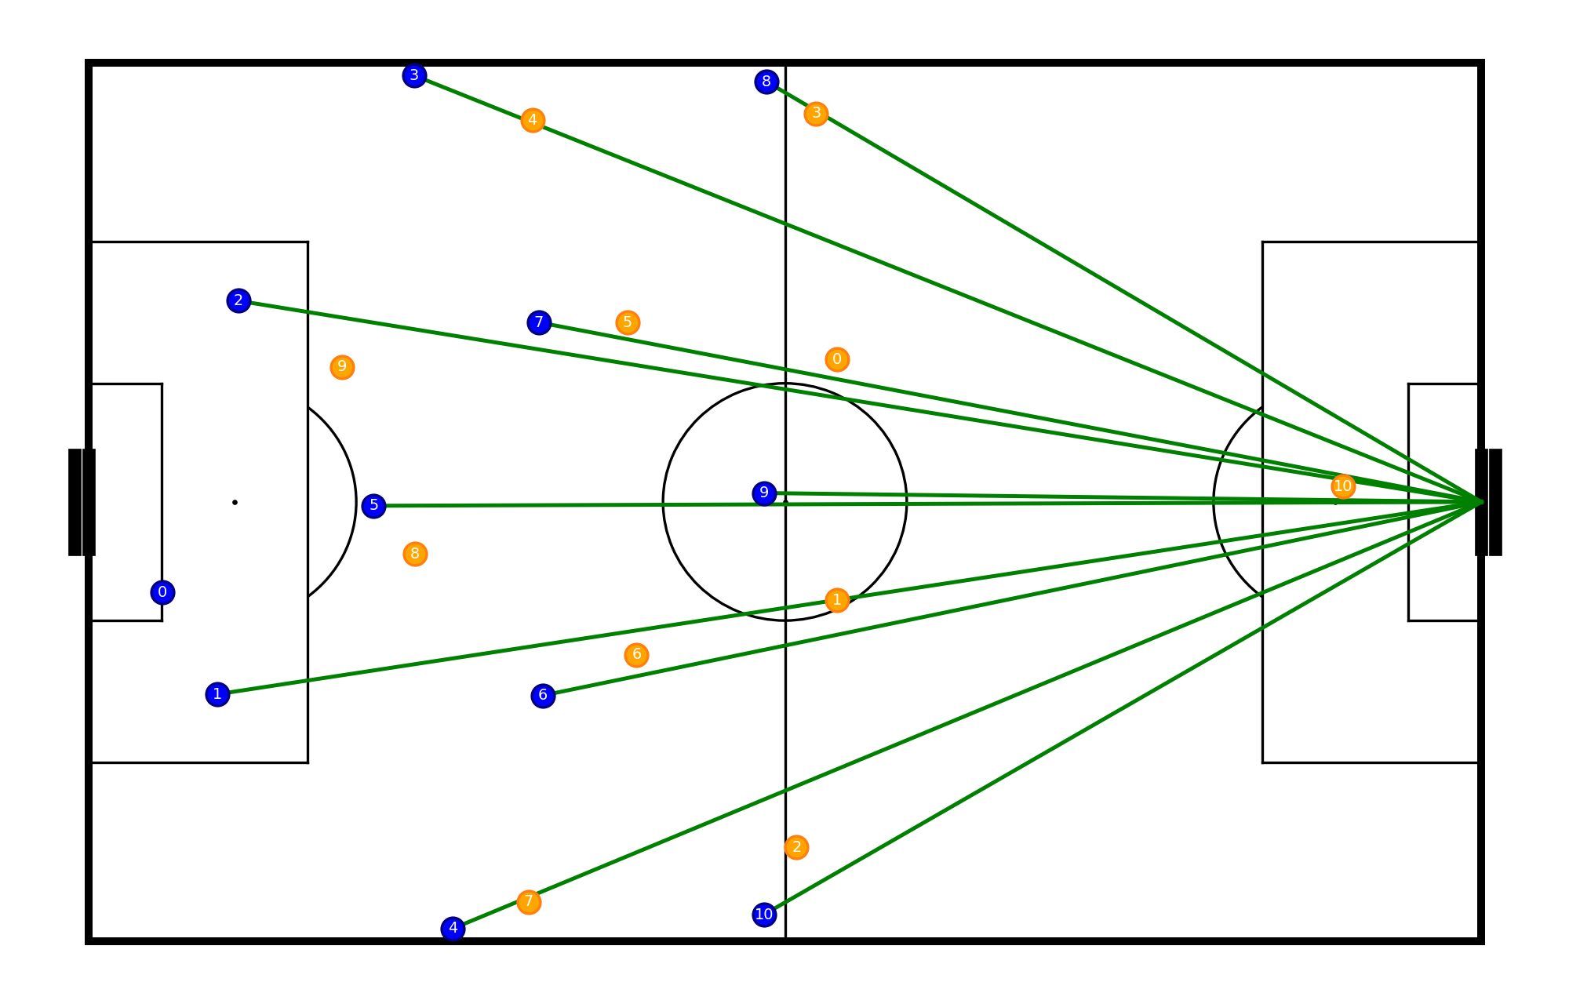
Criteria 2
Maximize coverage of pass lines
Maximize coverage of the goal line

Slide 8
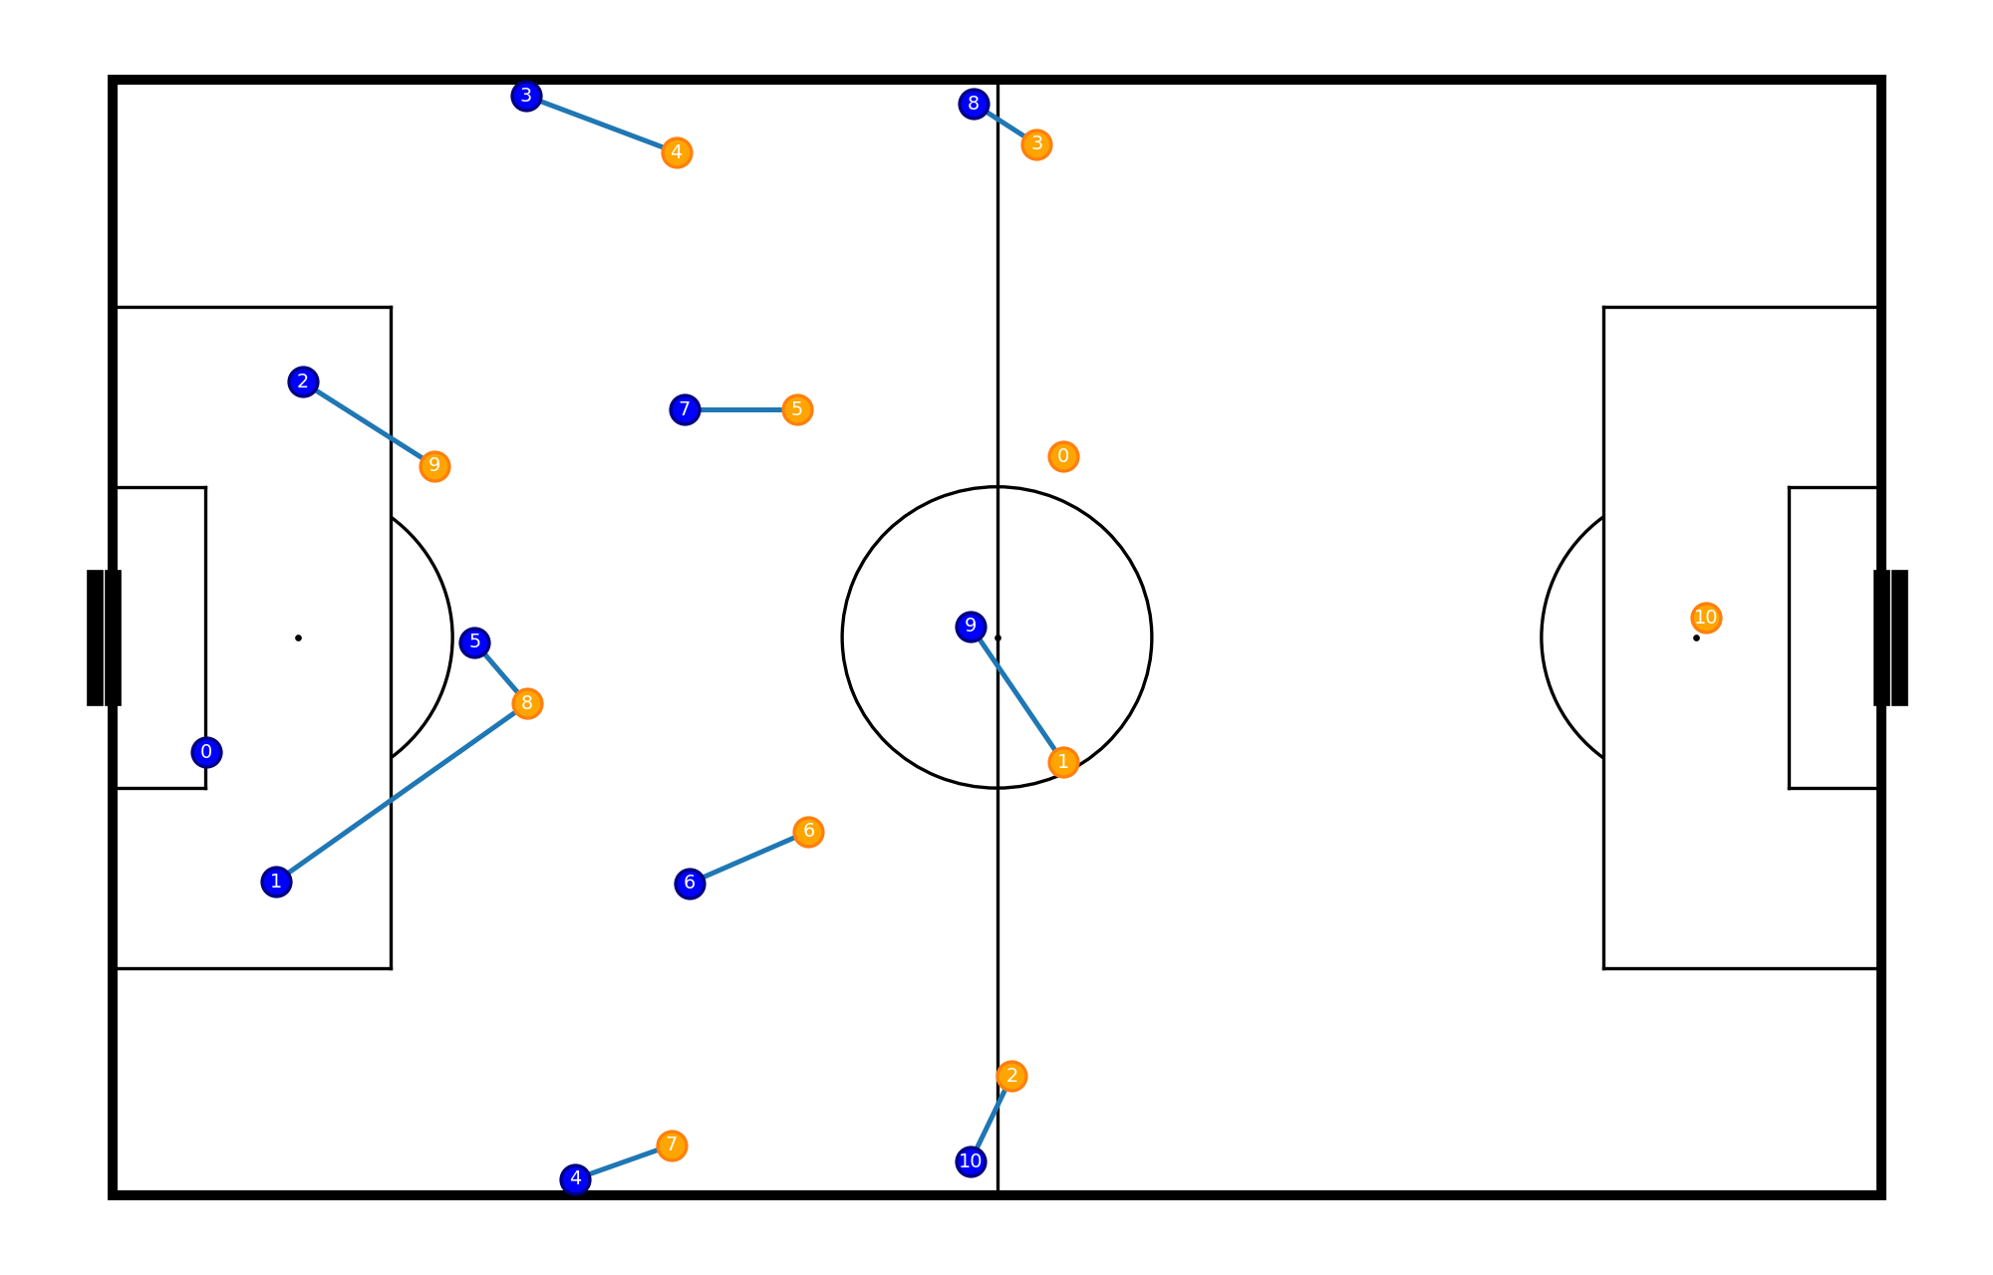
Criteria 3
Maximize coverage of pass lines
Maximize coverage of the goal line
Minimize the distance to opponent players

Slide 9
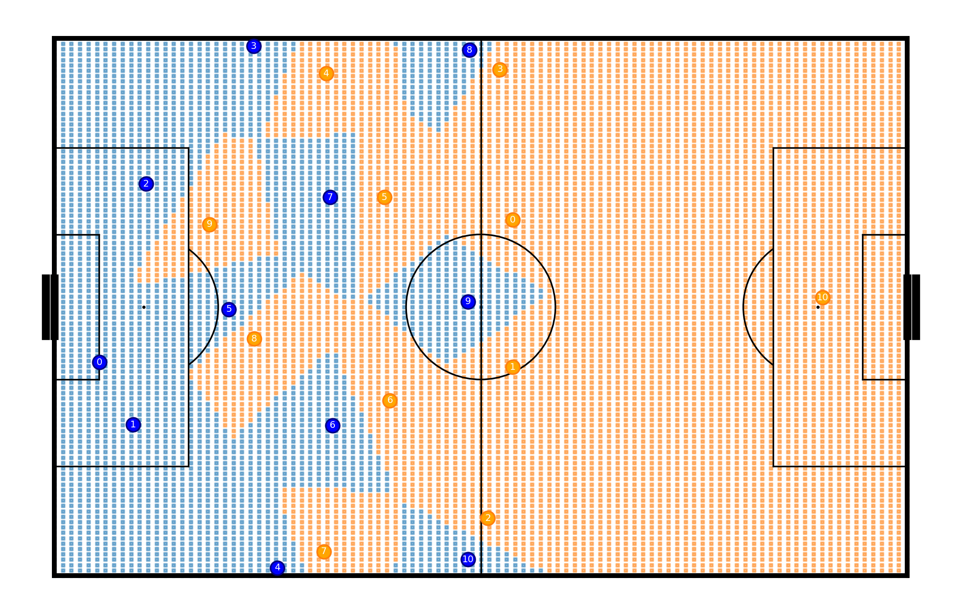
Criteria 4
Maximize coverage of pass lines
Maximize coverage of the goal line
Minimize the distance to opponent players
Maximize pitch control area

Slide 10

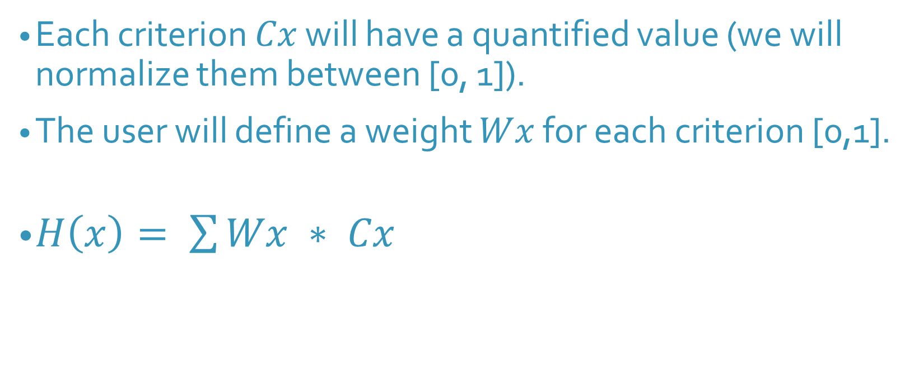
Heuristic
Each criterion $Cx$ will have a quantified value (we will normalize them between [0, 1]).
The user will define a weight $Wx$ for each criterion [0,1].
$H\left(x\right)= \sum{Wx ∗ Cx}$
$$x$$

Slide 11
Algorithms
Optuna (TPE/CMA-ES)
Hill Climbing, Simulated annealing
Genetic algorithms

Slide 12
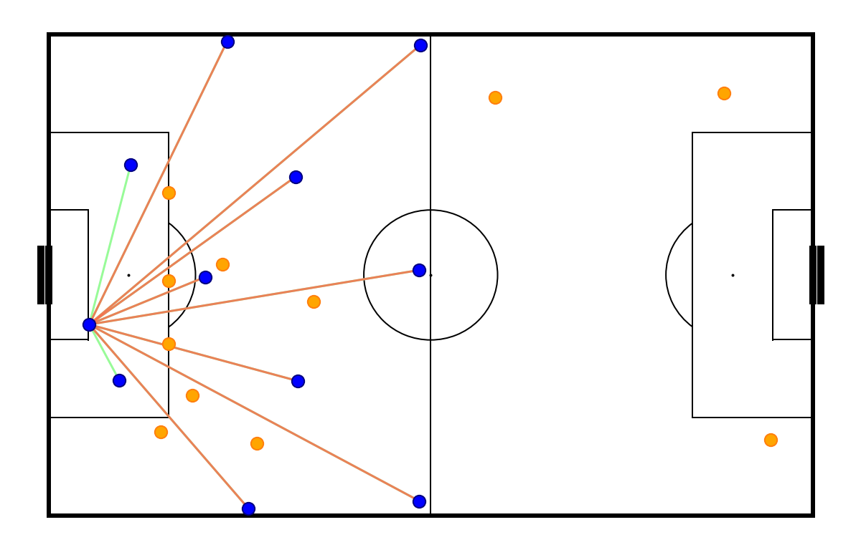
Progress
Implementation of the criterions and the framework for weight selection
Implementing the algorithms

Slide 13

Q&A

